Slide 1
Eeem068 applied machine learninG
Training Vision Transformers for Knee Abnormality Classification
Group Id: 07
Group representative: Poovarasan Pariselvam

Slide 2
Group Members
Kishore Damodharan
Deepakraj Rajmohan
Sriraaj Anandh
Rohidh Govindan Choodamani
Poovarasan Pariselvam
Teaching Assistant
Sadegh Rahmaniboldaji
(s.rahmani@surrey.ac.uk)

Slide 3
Problem Statement
The Clinical Reality
High prevalence of complex, co-occurring knee pathologies (e.g., ACL and meniscal tears).
Accurate and timely diagnosis is critical for optimal patient recovery outcomes.
The Diagnostic Bottleneck
While 3D Volumetric MRI is the gold standard, manual interpretation is heavily constrained:
Time-Intensive: High cognitive load for slice-by-slice analysis.
Resource-Dependent: Reliant on the limited availability of expert radiologists.
The AI Imperative
The Goal: Develop an automated, deep-learning-assisted diagnostic pipeline.
The Impact: Triage routine cases, reduce diagnostic latency, and augment clinical decision-making at scale.

Slide 4
Data Architecture: The MRNet Challenge
Provenance & Scale
Source: Clinical MRI dataset collected at Stanford University Medical Center.
Volume: 1,370 comprehensive examinations (1,130 Training / 120 Validation).
The Dimensionality Problem (Input Data)
Format: 3D Volumetric .npy arrays.
Spatial Resolution: High-fidelity 256 x 256 pixel slices.
The Challenge: Highly variable depth (20 to 50 slices per scan), requiring specialized 2D-to-3D aggregation strategies rather than standard batching.
The Multi-Label Complexity (Target Variables)
Conditions: Abnormal (80.6%), Meniscal Tear (37.1%), and ACL Tear (23.3%).
The Challenge: These conditions are not mutually exclusive. A single patient may present multiple co-occurring pathologies, necessitating three independent binary classification objectives rather than a standard single-label multi-class approach.

Slide 5
methodology
1. Data Adaptation (3D to 2D)
Action: Unroll variable-depth MRI volumes into sequential 2D slices.
Prep: Resize to 224 x 224 and duplicate to 3-channel RGB for transfer learning.
2. Spatial Extraction (ViT-Small)
Action: Pass each slice independently through a pre-trained ViT-S/16 backbone.
Focus: Extract [CLS] token embeddings to capture localized, complex anomalies (e.g., tears).
3. Volumetric Aggregation (2D to 3D)
Action: Apply Global Max Pooling across the slice dimension.
Result: Compresses the variable sequence of slice features into a single, unified patient-level vector.
4. Multi-Label Classification
Action: Pass the unified vector through a 3-node linear classifier.
Optimization: Use Binary Cross-Entropy (BCE) Loss to correctly model co-occurring conditions independently.

Slide 6
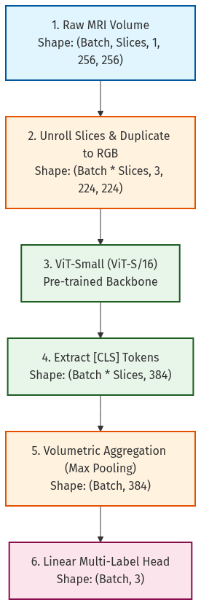
Methodology architecture

Slide 7
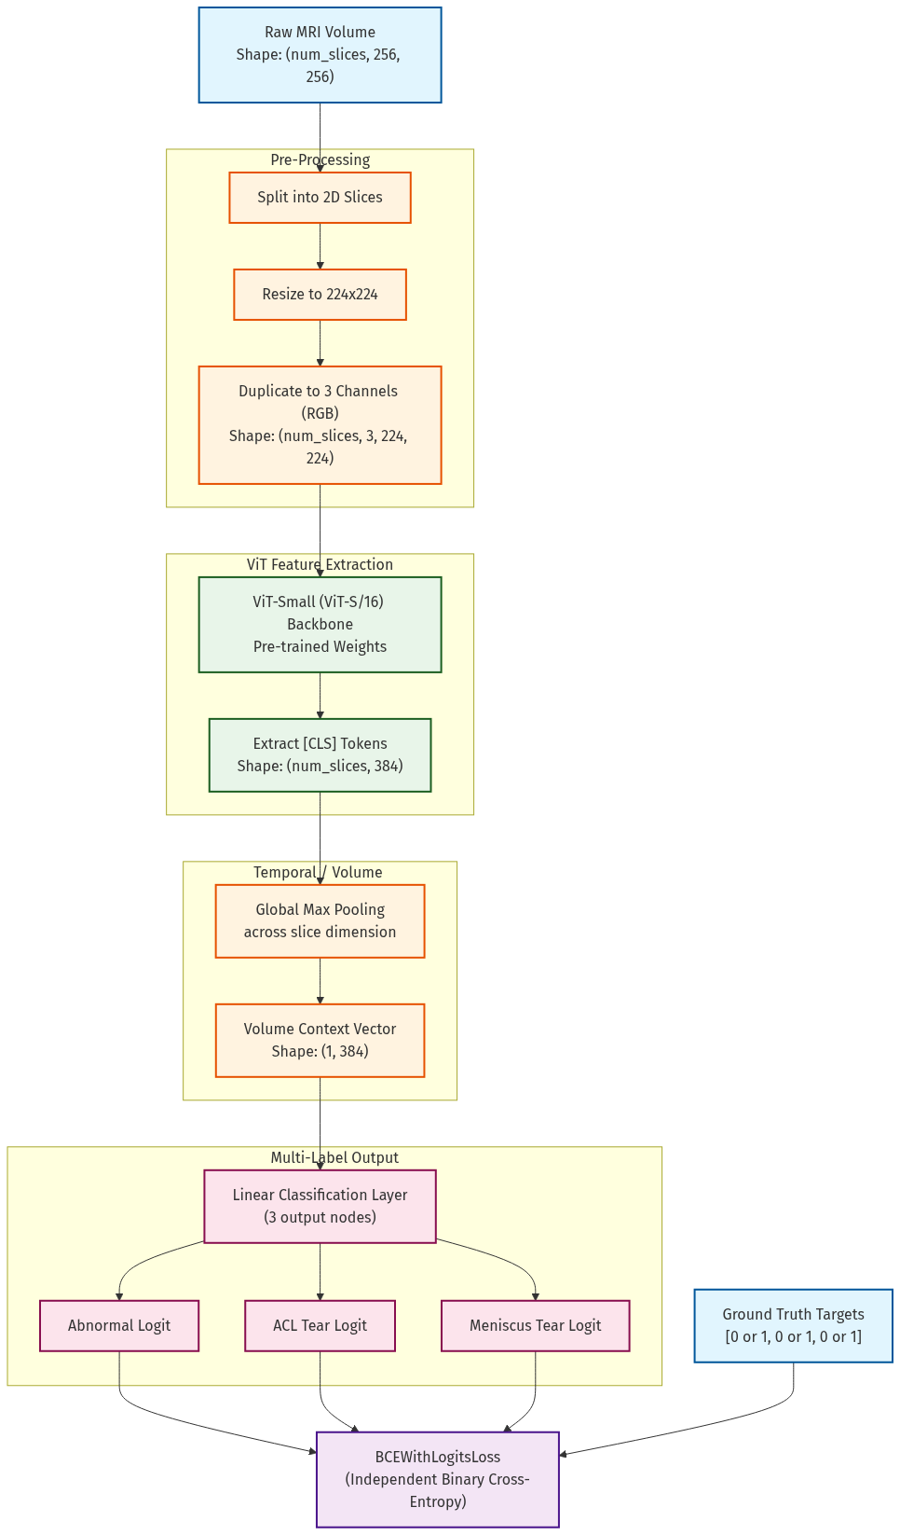
transformer architecture

Slide 8
Evaluation
Planned metrics for evaluation:
Accuracy
Precision
Recall
F1-score
AUC-ROC
Additional:
Confusion matrix
Attention visualisation
OOD testing

Slide 9
Collaborative Development Plan
Phase | Description | Contribution
Data Understanding | MRI structure, labels, imbalance | All members
Preprocessing | 3D → 2D, slice strategy | All members
Model Development | ViT implementation & tuning | All members
Training | Experiments & hyperparameters tuning | All members
Evaluation | Metrics, AUC, analysis | All members
Visualization | Attention maps, plots | All members
Report & PPT | Writing + explanation | All members
The provided plan involves the participants in all stages to understand complete pipeline

Slide 10
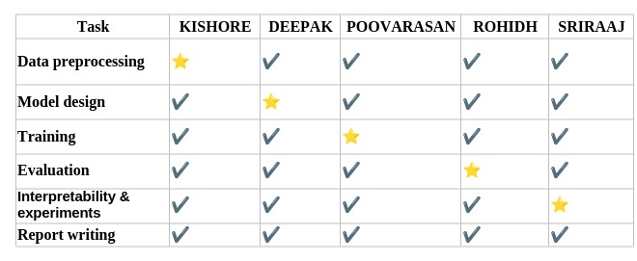
Collaborative Development Plan

Slide 11
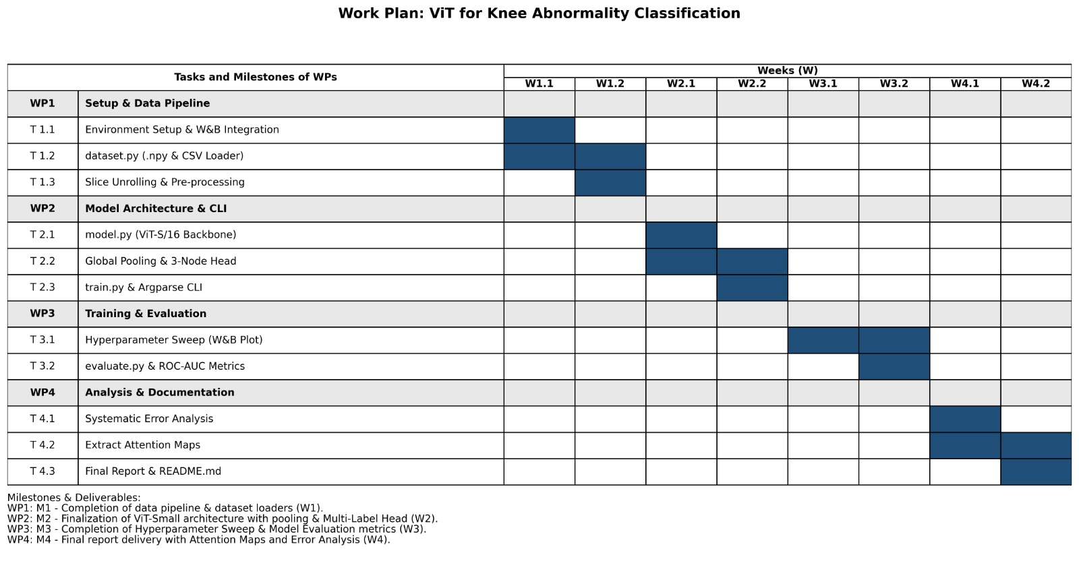
Gantt Chart

